Slide 1


Slide 2
Agenda
What is Camunda
About Camunda
What is Camunda Platform 8
Zeebe Architecture
Zeebe Client / Server
Data Replication – Fault Tolerance
Zeebe in Microservice Orchestration
Event based service Orchestration
Zeebe Kafka Integration

Slide 3

What is Camunda
Camunda business process management is an open-source platform that allows users to create and deploy workflows and automate decisions.
Camunda comes with several user-friendly interfaces to develop workflows and deploy those.
Camunda is a developer-friendly workflow automation engine for business processes.
Camunda Platform ships with tools for creating
Business Process workflow (Camunda Modeler)
Camunda Cockpit
Camunda Tasklist

Slide 4
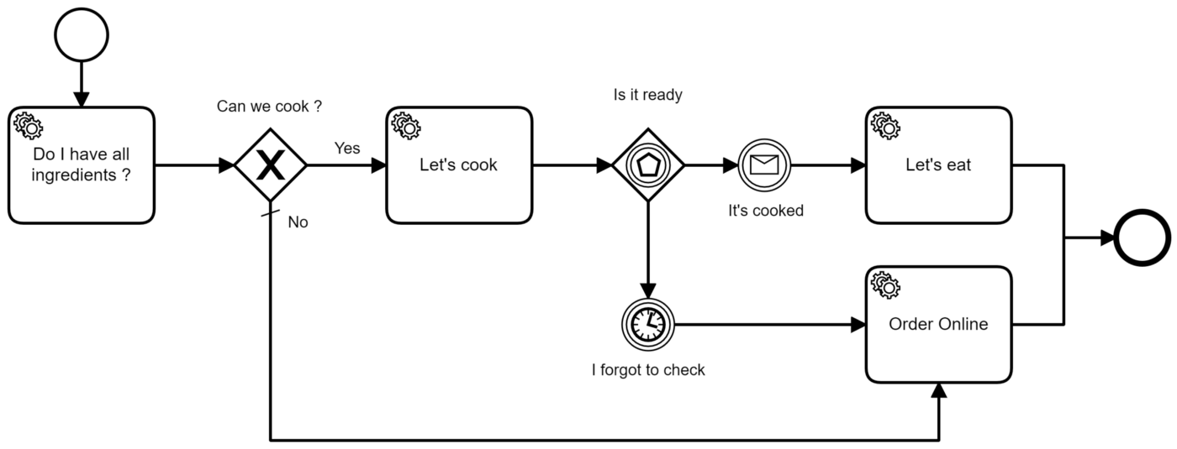
Camunda Simple Workflow

Slide 5
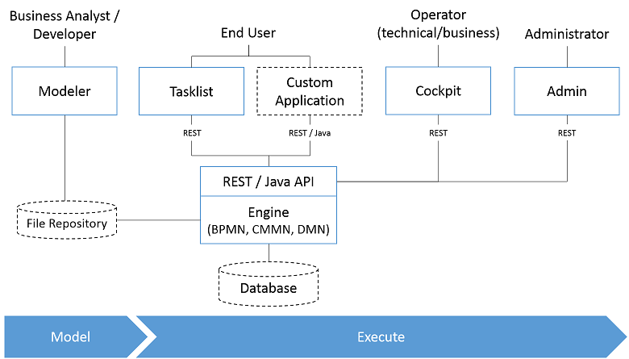
About Camunda
Camunda is open-source and Light Weighted,
Supports micro-service architectures and ships with an extensive REST API.
Automate Any Process, Anywhere

Slide 6
What is Camunda Platform8
Camunda Platform 8 is comprised of below components:
Zeebe - Zeebe is the cloud-native process engine of Camunda Platform 8.
Operate - Manage, monitor, and troubleshoot your processes through Operate.
Optimize - Improve your processes by identifying constraints in your system with Optimize.
Tasklist - Use Tasklist to complete tasks which need human input.
Console - Configure and deploy clusters with Console.
Web Modeler - Model processes, deploy and start new instances all without leaving Camunda Platform 8.

Slide 7
What is Zeebe
Zeebe is a cloud-native workflow engine for microservices orchestration
Define processes graphically in BPMN 2.0.
Choose any gRPC-supported programming language to implement your workers.
Build processes that react to events from Apache Kafka messaging system.
Use as part of a software as a service (SaaS) offering with Camunda Platform 8 or deploy with Docker and Kubernetes (in the cloud or on-premises) with Camunda Platform 8 Self-Managed.
Scale horizontally to handle very high throughput.
Export processes data for monitoring and analysis - Elasticsearch exporter

Slide 8
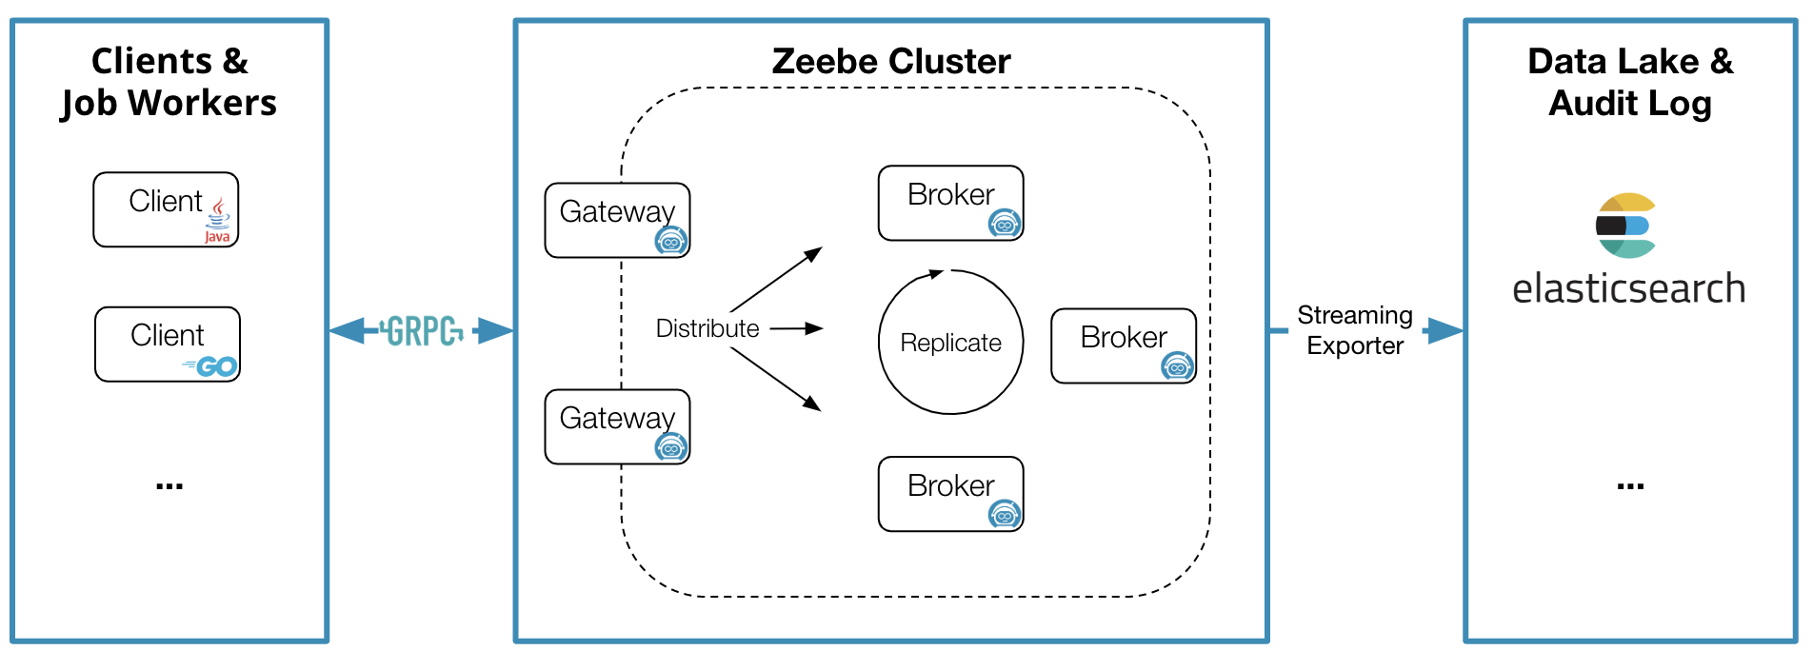

Zeebe Architecture
Four Main Components
Clients – Job Workers
Gateways
Brokers
Exporters

Slide 9
Zeebe Architecture
Clients
Clients send commands to Zeebe to:
Deploy processes
Start process instances
Publish messages
Activate jobs
Complete jobs
Fail jobs
Handle operational issues
Update process instance variables
Resolve incidents
Workers
A job worker is a Zeebe client that uses the client API to first activate jobs, and upon completion, either complete or fail the
Gateways
A gateway serves as a single-entry point to a Zeebe cluster and forwards requests to brokers.
The gateway is stateless and session lesss, and gateways can be added as necessary for load balancing and high availability

Slide 10
Zeebe Architecture
Brokers
The Zeebe broker is the distributed workflow engine that tracks the state of active process instances.
Brokers can be partitioned for horizontal scalability and replicated for fault tolerance. A Zeebe deployment often consists of more than one broker.
It's important to note that no application business logic lives in the broker. Its only responsibilities are:
Processing commands sent by clients
Storing and managing the state of active process instances
Assigning jobs to job workers
Brokers form a peer-to-peer network in which there is no single point of failure. This is possible because all brokers perform the same kind of tasks and the responsibilities of an unavailable broker are transparently reassigned in the network

Slide 11
Zeebe Architecture
Exporters
The exporter system provides an event stream of state changes within Zeebe.
Monitoring the current state of running process instance
Analysis of historic process data for auditing, business intelligence, etc.
Tracking incidents created by Zeebe
Elasticsearch, Kafka, Hazlecast Exporters

Slide 12
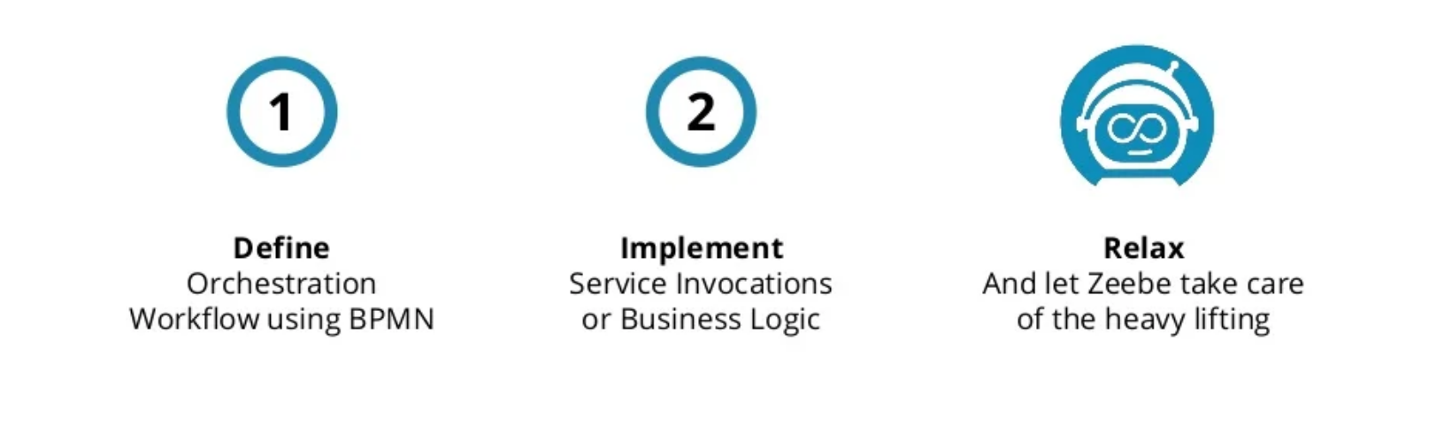
Zeebe Solution

Slide 13
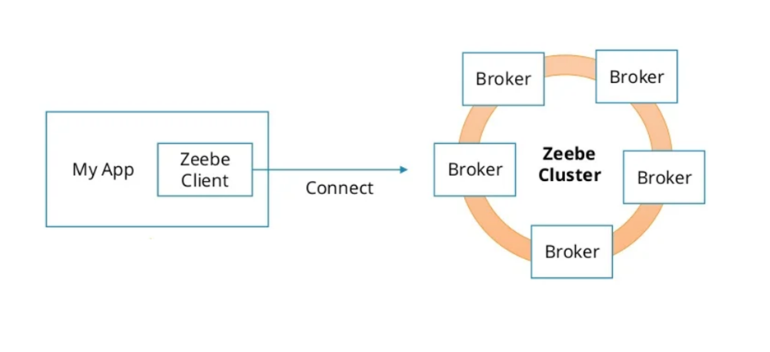
Client / Server
Zeebe can operate as a cluster of brokers, forming a peer-to-peer network.
In this network, all brokers have the same responsibilities

Slide 14
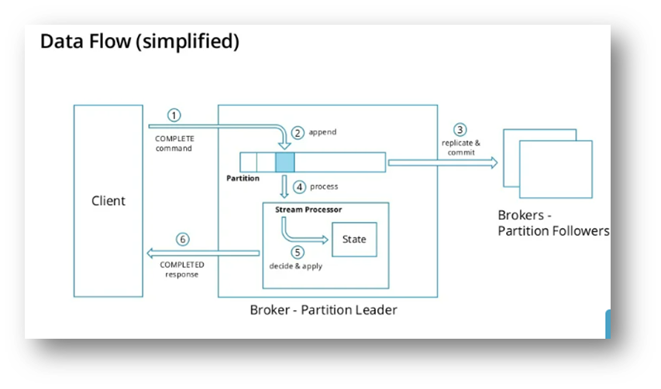
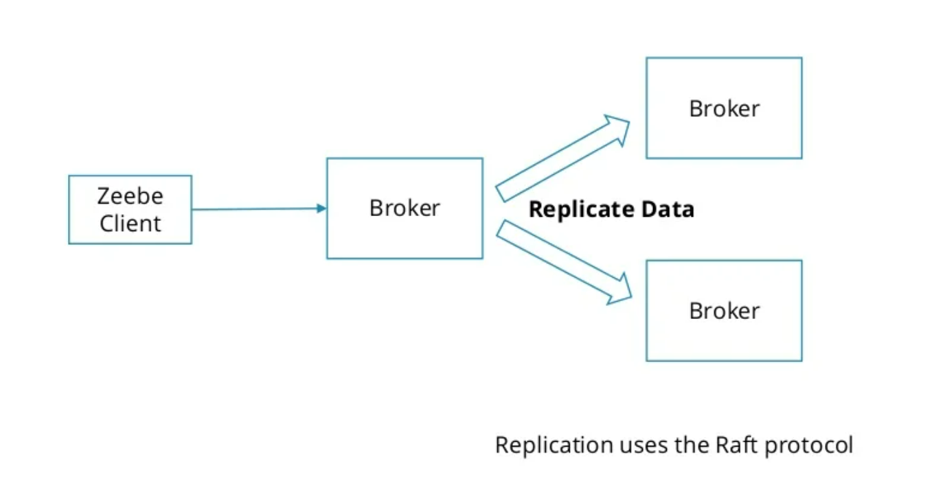
Data Replication – Fault Tolerance

Slide 15
Orchestration of Microservices
Microservices
Microservices
Microservices
Microservices
Distribute Work
Zeebe
Broker

Slide 16
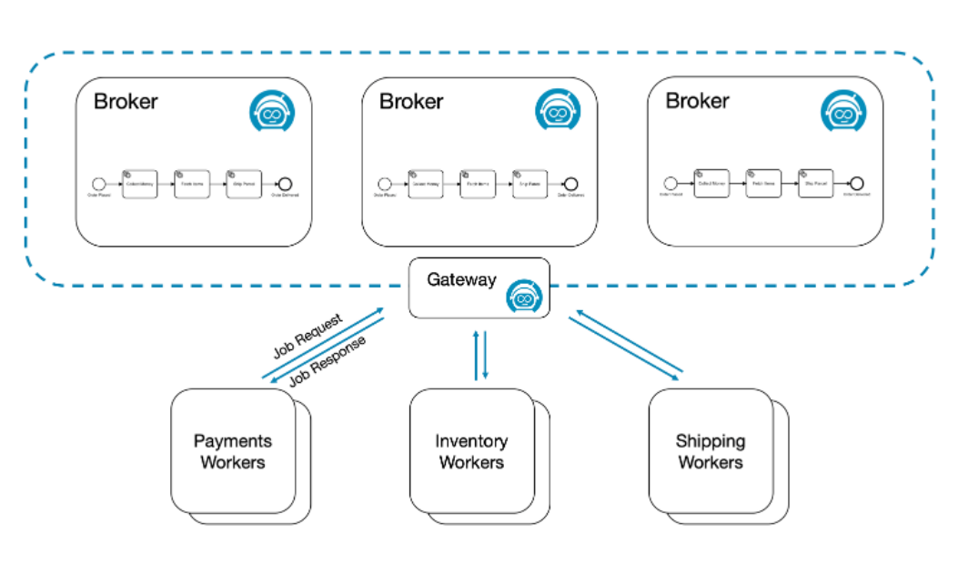
Zeebe Worker

Slide 17
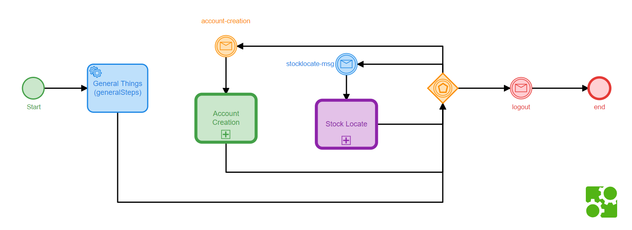
Event based service Orchestration

Slide 18
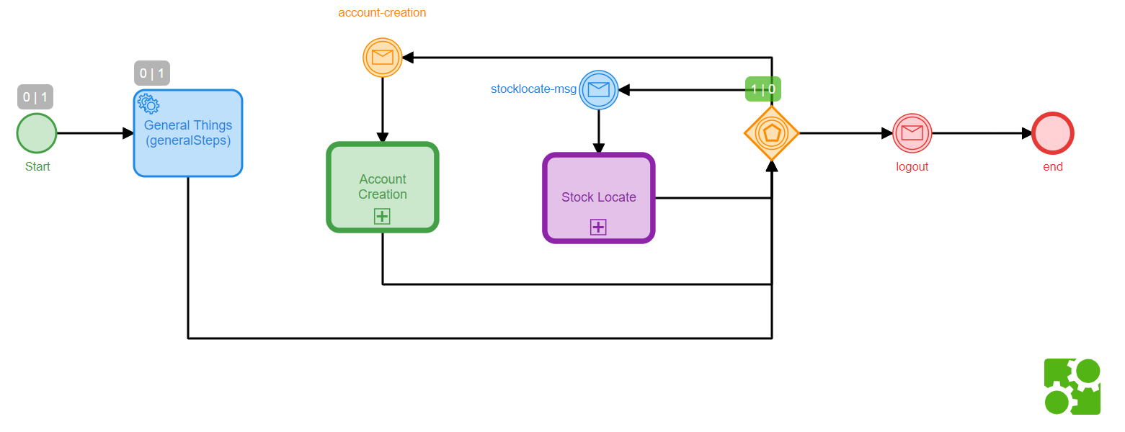

Event based service Orchestration – Running State

Slide 19
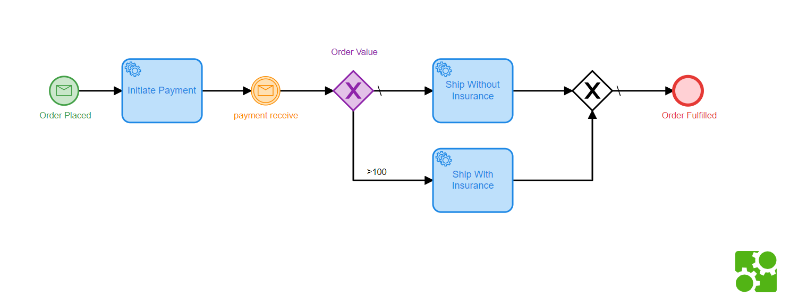
Zeebe Kafka Integration

Slide 20
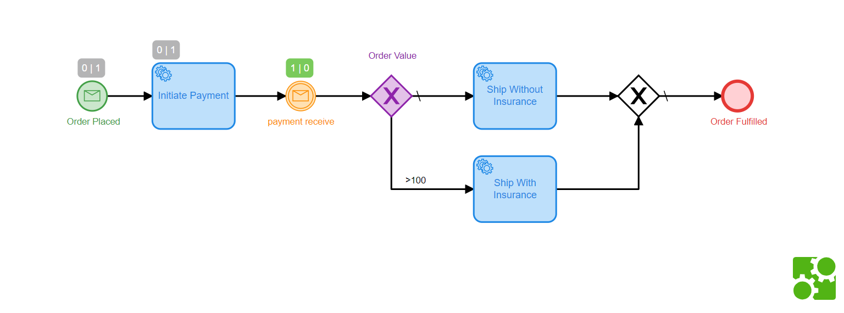
Zeebe Kafka Integration– Running State

Slide 21
Thank You!

